Slide 1
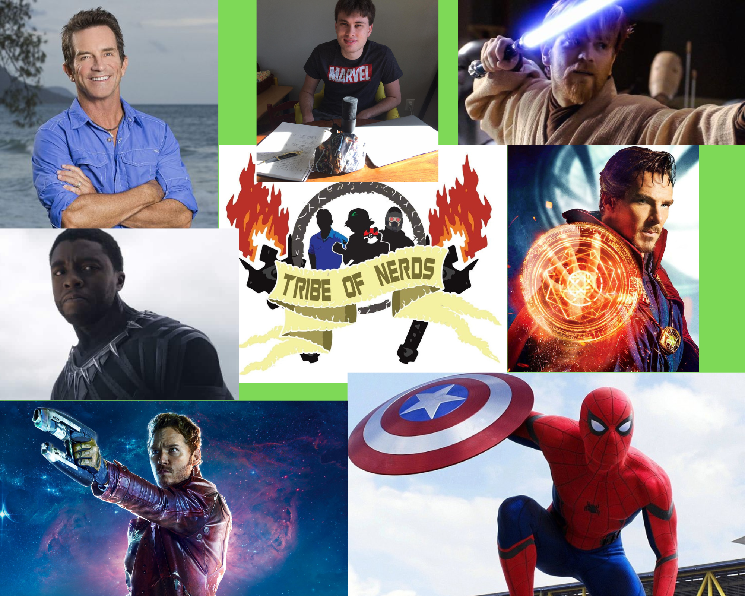
CIT180 Final Project
Jake Borucki

Slide 2
Purpose of the Site
My purpose of this website was to share my love and passion for the Marvel Cinematic Universe, which is a franchise that is really special to me. I wanted to show off some of the recent movies or shows that were either some of my favorites or major pop culture talking points.

Slide 3
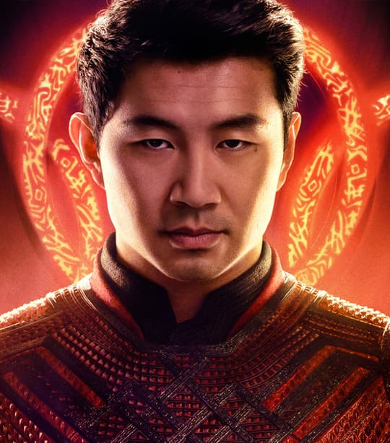
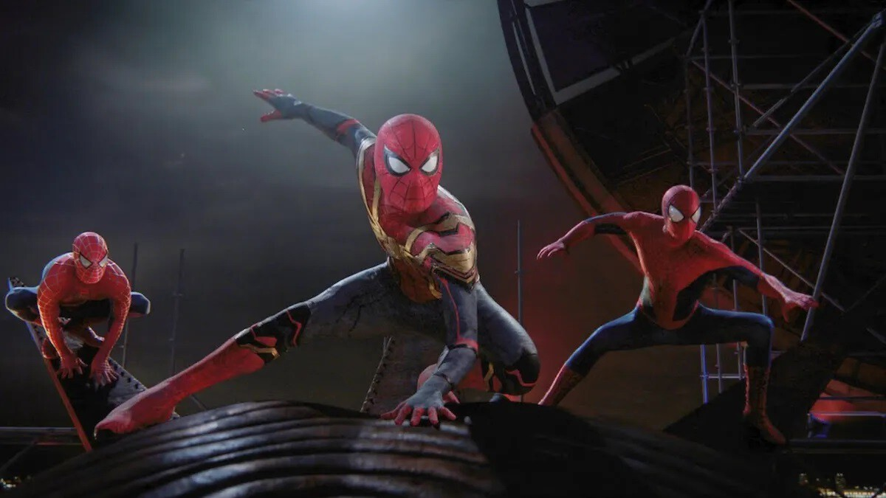
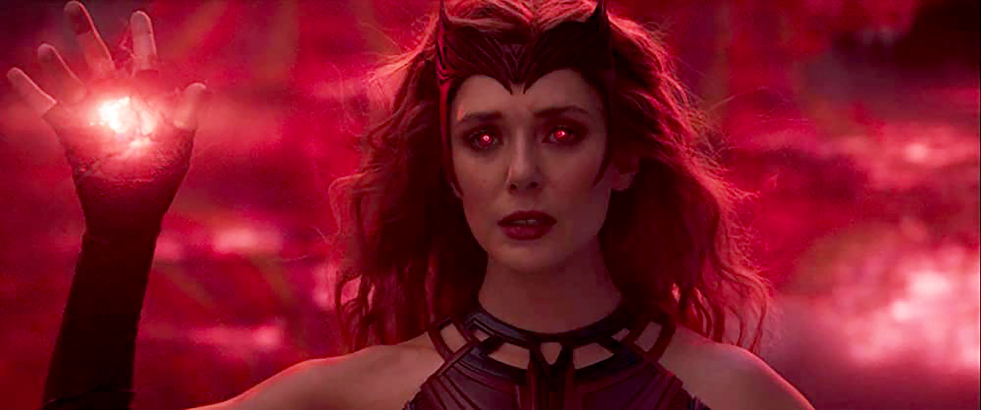
Intended Audience
My target audience is anyone who loves superhero movies and enjoys these characters and this universe.

Slide 4
Color Scheme
I wanted to choose a color scheme that was similar to the Marvel Studios Logo, while also being colorful like the pages of a comic book. The icon bar is green because green is also my favorite color.

Slide 5
Layout and Design
I decided to go with more of a grid-view design because of the previous projects I used with it where I liked the overall look of it better than the other layout choices. I chose a vertical menu so that you can see the links to go to the Rotten Tomatoes reviews much more easily. I thought linking to reviews of these movies would be cool to take a look at how critics and audiences felt about the movies or shows I have listed.

Slide 6
Challenges
I think I had a lot of trouble with figuring out how to implement the CSS correctly to make the page look how I intended. I was able to ask for help and then figure out how to fix it using the help I received.

Slide 7
What I Did Well
I think that I had a topic that I could easily build my website around and make stand out. It made the process of planning this final project much easier.

Slide 8
What I Could Improve
I could improve on website design. I think while I made what I intended, I think there are things I could have done to make it better such as making the pictures smaller with wraparound text, and maybe adding more options with perhaps the movies or shows that were not as well received by critics or fans.

